Slide 1
Filters Listeners

Slide 2
Filters
Servlet Filters can be used for the following purposes:
To intercept the requests coming from a client before they access a resource at back end.
To manipulate responses from server before they are sent back to the client.
can intercept and redirect processing
security
auditing
can modify requests and responses
data conversion (XSLT, gzip, ...)
specialized caching
– all without changing the existing servlet code!

Slide 3
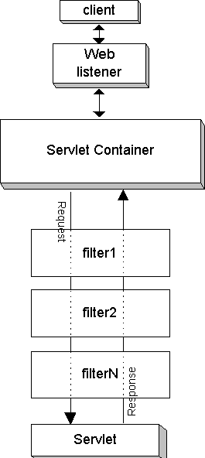
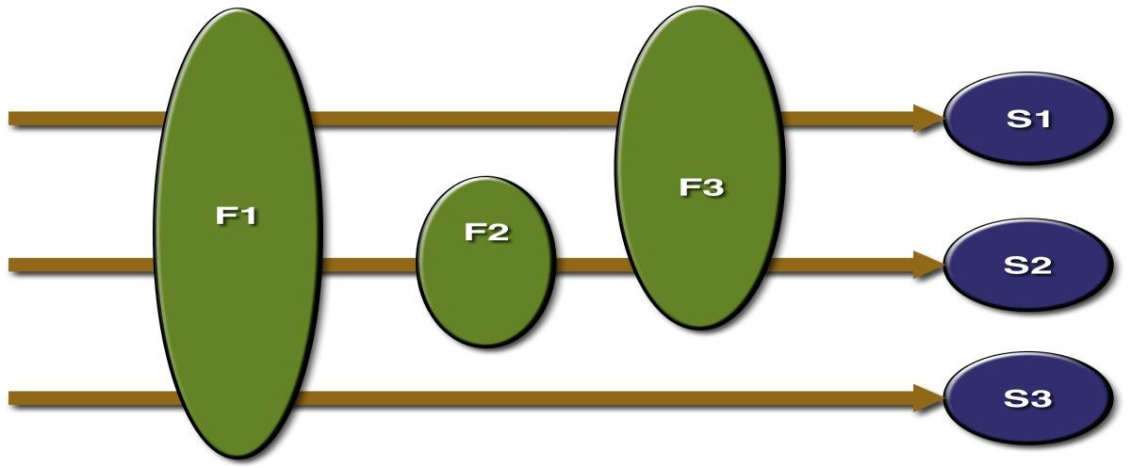
Filters
A common scenario for a filter is one in which you want to apply pre-processing or post-processing to
requests or responses for a group of servlets, not just for a single servlet.
If you need to modify the request or response for just one servlet, there is no need to create a filter—just do what is required directly in the servlet itself.
We can map a filter to one or more Web resources, and you can map more than one filter to a web resource as shown below:
Filter F1 is mapped to Servlets S1, S2, and S3, filter F2 is mapped to Servlet S2, and filter F3 is mapped to Servlets S1 and S2.

Slide 4
Filter Lifecycle
When the web application starts up, the Servlet Container will create an instance of the filter and keeps
it in memory during web application's lifetime.
The same instance will be reused for every incoming request whose URL matches the filter's URL pattern. The doFilter() method will then be called on every request.
Filters are not Servlets.
So they do not implement and override HttpServlet methods such as doGet() or doPost().
Rather, a filter implements the methods of the javax.servlet.Filter interface.
The methods are:
init()
destroy()
doFilter()

Slide 5
Filter API
The Filter API consists of three interfaces: 1.javax.servlet.Filter 2.javax.servlet.FilterChain 3.javax.servlet.FilterConfig
Methods in javax.servlet.Filter interface:
Method | Description
public void init(FilterConfig filterConfig) | Called by the web container to indicate to a filter that it is being placed into service.
public void doFilter(ServletRequest request, ServletResponse response, FilterChain chain) | The doFilter() method is called by the container each time a request/response pair is passed through the chain due to a client request for a resource at the end of the chain.
public void destroy() | Called by the web container to indicate to a filter that it is being taken out of service.
Note : To create a filter class you must implement the javax.servlet.Filter interface and define all the above methods.

Slide 6
javax.servlet.FilterConfig interface
The javax.servlet.FilterConfig interface is an argument to the init() method.
This interface contains information about initial parameters and provides access to the
ServletContext as well.
Methods in javax.servlet.FilterConfig interface
Method | Description
public String getFilterName() | Returns the filter-name of this filter as defined in the deployment descriptor.
public ServletContext getServletContext() | Returns a reference to the ServletContext in which the caller is executing.
public String getInitParameter(String name) | Returns a String containing the value of the named initialization parameter, or null if the parameter does not exist.
public Enumeration getInitParameterNames() | Returns the names of the filter's initialization parameters as an Enumeration of String objects, or an empty Enumeration if the filter has no initialization parameters.

Slide 7
javax.servlet.FilterChain interface
The javax.servlet.FilterChain interface is an argument to the doFilter() method.
This interface has only one method, doFilter(), which causes the next filter in the chain to be invoked.
Methods in javax.servlet.FilterChain interface
Method | Description
public void doFilter(ServletRequest request, ServletResponse response) | Causes the next filter in the chain to be invoked, or if the calling filter, is the last filter in the chain, causes the resource at the end of the chain to be invoked.

Slide 8
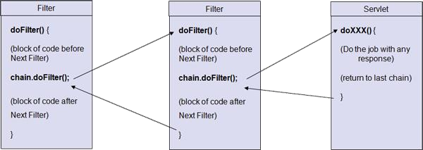
Filter Chain
The filter chain

Slide 9
Using @WebFilter Annotation
@WebFilter has the following attributes :
filterName description displayName initParams servletNames value urlPatterns dispatcherTypes asyncSupported
Ex. @WebFilter(filterName="/LogA",urlPatterns="/LoginServlet",
initParams={@WebInitParam(name="message",value="Hello“) }
)

Slide 10
Listeners
The Servlet specification includes the capability to track key events in your web applications through event listeners. This functionality allows more efficient resource management and automated processing based on event status.
Listeners introduced in Servlet 2.3 API recognize application events which help web developers in controlling the life cycle of the ServletContext, ServletRequest, and HttpSession objects.
Servlet Listeners are used to listen to the key events in a web container, such as web application initialization/shutdown , create/invalidate a session, or add/remove an attribute in an session or manage number of concurrent users etc.
In design pattern terms – observer pattern: An observer (in this case the listener) is notified when
an event occurs in the subject (server).
Note:
Use a Listener if you want to intercept key changes in the lifecycle of objects.
10

Slide 11

Event Types and corresponding Listener Interfaces
Scope Level Events | Event Type | Description | Listener Interface | Methods
Application Level Events | Lifecycle events | Occur when either a servlet context is initialized or destroyed | ServletContext Listener | void contextInitialized(ServletContextEvent) void contextDestoyed(ServletContextEvent)
 | Changes to ServletContext attributes | Occur when a new attribute of the ServletContext interface is added or an existing attribute is removed or replaced by | ServletContext AttributeListen er | void attributeAdded(ServletContextAttributeEvent) void attributeReplaced(ServletContextAttributeEvent) void attributeRemoved(ServletContextAttributeEvent)

Slide 12

Event Types and corresponding Listener Interfaces
Scope Level Events
Event Type Description Listener Interface Methods
Lifecycle events
Occur when an instance of HttpSession is created, invalidated, or destroyed
HttpSessionListener
void sessionCreated(HttpSessionEvent)
void sessionDestroyed(HttpSessionEvent)
Session Level Events
Changes to HttpSession attributes
Occur when a new attribute of the HttpSession instance is added or an existing attribute is removed or replaced by another attribute
HttpSessionAttribute Listener
void attributeAdded(HttpSessionBindingEvent
void attributeReplaced(HttpSessionBindingEve
void attributeRemoved(HttpSessionBindingEve

Slide 13
Event Types and corresponding Listener Interfaces
Scope Level Events | Event Type | Description | Listener Interface | Methods
 | Lifecycle events | Occur when a servlet | ServletRequestListe | void
 |  | processes a | ner | requestInitialized(ServletRequestEv
 |  | ServletRequest instance |  | ent)
Request
Level Events |  |  |  | void
 |  |  |  | requestDestroyed(ServletRequestE
 |  |  |  | vent)
 | Changes to | Occurs when a new | ServletRequestAttri | void
 | ServletRequest | attribute is added or an | buteListener | attributeAdded(ServletRequestAttr
 | attributes | existing attribute is |  | ibuteEvent)
 |  | removed or replaced by
 |  | another attribute of |  | void
 |  | ServletRequest instance |  | attributeReplaced(ServletRequestA
 |  |  |  | ttributeEvent)

Slide 14
Implementing Listener Interfaces
In a web application, multiple listeners may co-exist.
To apply listeners to our web application, perform the following:
Create a class that implements the appropriate Listener interface
Register the listener in the deployment descriptor file (web.xml) or use Annotations.
Note: Listeners are implicitly instantiated by the Servlet Container when the web application is loaded.

Slide 15
ServletContextListener Example
Note: Use either annotation or declare in web.xml
@WebListener
public class MyContextListener implements ServletContextListener {
public void contextInitialized(ServletContextEvent sce) { ServletContext context = sce.getServletContext(); System.out.println("ServletContext is initialized");
}
public void contextDestroyed(ServletContextEvent sce) {
<listener> web.xml
<listener-class>
org.asr.listeners. MyContextAttributeListener
</listener-class>
</listener>
sce.getServletContext().log("Servlet Context object destroyed"); }
}
Output on the server console when you run the application and after stopping the server.
ServletContext is initialized
…….
INFO: Server startup in 455 ms
…………
INFO: Stopping service Catalina
ServletContext is about to be destroyed

Slide 16
ServletRequestListener Interface
The ServletRequestListener allows the developers to monitor the request coming in and out of scope in a web component. For example we can count the number of requests our Servlet receives by incrementing a static variable.
The ServletRequestListener has the following two methods:
public void requestInitialized(ServletRequestEvent e)
This method will be executed automatically by the web container at the time of request object creation i.e. just
before invoking service method.
public void requestDestroyed(ServletRequestEvent e)
This method will be executed by the web container at the time of request object destroy i.e. just after completion of service ().
The ServletRequestEvent class which is a sub class of java.util.Event defines the following two methods:
public ServletRequest getServeltRequest() - returns the ServletRequest that is changing.
public ServletContext getServeltContext() - returns the ServletContext of this web application.

Slide 17
ServletRequestListener Example
@WebListener
public class ServletRequestListenerDemo implements ServletRequestListener { public static int count=0;
public void requestDestroyed(ServletRequestEvent sre) {
System.out.print("The Request object destroyed at :"+new java.util.Date());
}
public void requestInitialized(ServletRequestEvent sre) {
count++;
System.out.print("Request Object created At:"+ new java.util.Date());
System.out.print("The hit count for this web application :"+count);
}
}
@WebServlet("/HitCountServlet")
public class HitCountServlet extends HttpServlet {
protected void doGet(HttpServletRequest request, HttpServletResponse response) throws
ServletException, IOException {
PrintWriter out = response.getWriter(); out.print("<h2> This is target Servlet </h2>");
out.print("<h2>No. of hits for this application :"+ServletRequestListenerDemo.count);
}
}

Slide 18

Thank You!

